Slide 1
FY 2018
President’s Budget
Stakeholders Briefing
May 30, 2017

Slide 2
The FY 2018 budget continues to support Reclamation’s mission.
The mission of the Bureau of Reclamation is to manage, develop, and protect water and related resources in an environmentally and economically sound manner in the interest of the American public.
2

Slide 3
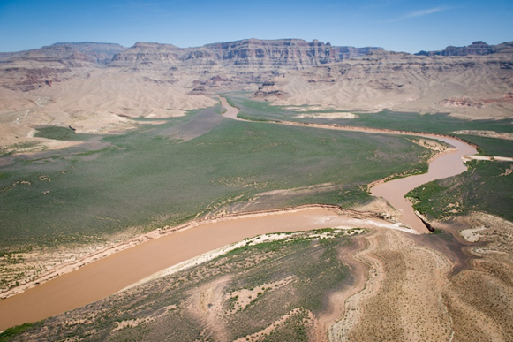
Reclamation in the West
The budget sustains Reclamation’s participation in efforts to address water supply challenges in the West to ensure the efficient generation of energy, varied use of our resources, celebration of America’s great recreation opportunities, and to fulfill our commitments to tribal nations. The 2018 budget prioritizes funding to projects and programs that most effectively implement Reclamation’s programs and its management responsibilities for its water and power resources and infrastructure in the West.
Aerial views of the Colorado River in the upper end of Lake Mead (water level 1,097 ft.) and continuing to the delta of the lake at the lower end of the Grand Canyon.

Slide 4
Reclamation and the Economy
DOI Economic Report 2016
Reclamation activities are estimated to contribute approximately $48.1 billion in economic output, and support approximately 388,000 jobs annually
Reclamation & Jobs
Western economies are built on Reclamation water projects
Maintain and improve existing infrastructure
Help develop and construct new infrastructure
Environmental Restoration supports recreation based services
Hydropower supports new energy initiatives (ancillary services)
Many Reclamation dollars leverage other Federal and non-Federal dollars
Approximately $860 million in FY 2018
Reclamation’s projects and programs are integral to rebuilding American infrastructure and supporting the Nation’s long-term competitiveness

Slide 5
FY 2018 Secretarial Initiatives and Other Top Priorities
Energy
Land and Water Stewardship
Tribal Nations
Recreation and Sporting
Infrastructure and Safety
Management and Efficiencies
Invasive Species
California Water
Colorado River
Research and Development

Slide 6
History of Appropriations
(in millions)
*Does not include Desert Terminal Lakes in 2014 ($150M)

Slide 7
FY 2018 President’s Budget (in thousands)
Appropriation | FY 2016 Enacted^{1/} | FY 2017 Annualized CR^{2/} | FY 2017 Enacted^{1/} | FY 2018 President’s Budget
Water & Related Resources | 1,118,972 | 1,116,845 | 1,155,894 | 960,017
San Joaquin River Restoration Fund | [35,000] | [34,933] | [36,000] | [34,000]
Indian Water Rights Settlements | [112,483] | [112,269] | [106,151] | [98,569]
Subtotal: | 1,118,972 | 1,116,845 | 1,155,894 | 960,017
Policy and Administration | 59,500 | 59,387 | 59,000 | 59,000
California Bay-Delta | 37,000 | 36,933 | 36,000 | 37,000
Central Valley Project Restoration Fund | 49,528 | 49,434 | 55,606 | 41,376
Total: Gross Current Authority | 1,265,000 | 1,262,596 | 1,306,500 | 1,097,393
CVP Restoration Fund Offset | (49,528) | (49,434) | (55,606) | (41,376)
Total: Net Current Authority | 1,215,472 | 1,209,394 | 1,250,894 | 1,056,017
^{1/}FY 2016 included $166.332 million in additional funds provided by Congress, and FY 2017 includes $200.341 million in additional funds provided by Congress
^{2/}The FY 2017 Annualized CR total is a formula based on FY 2016
Enacted totals
Notes:
)

Slide 8
FY 2018 President’s Budget
Total = $1,097.4 (in millions)
$59.0
P&A
$960.0
Water & Related Resources
*W&RR includes $98.6 million for Indian Water Rights Settlements and $34.0 million for San Joaquin River Restoration

Slide 9
FY 2018 President’s Budget
Water & Related Resources
Total = $960.0 (in millions)
RESOURCES MGMT & DEVELOPMENT
$510.8
OPERATIONS, MAINT. & REHAB
$449.2

Slide 10
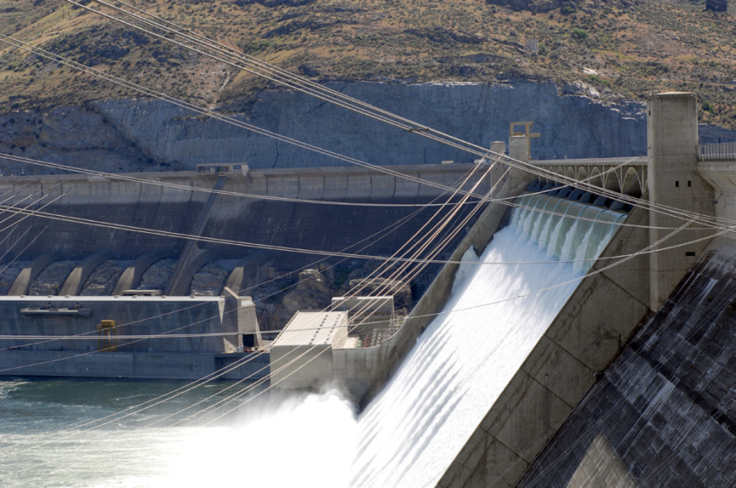
Energy
The FY 2018 President’s Budget allocates $1.3M to support sustainable hydropower initiatives that deliver value to Reclamation projects
Goal is to achieve operational efficiencies of hydropower facilities and promote development of new, non-federal hydropower on existing non-powered Reclamation facilities
Small Federal investment leverages large non-Reclamation investments (e.g., Bonneville Power Administration, other power customers)
Funding supports ongoing work for automated data collection, performance testing, regulatory compliance, etc.
Note: Entirety of Reclamation’s hydropower generation funding is nearly $500 million annually, of which approximately 80% is funded directly by power users. Reclamation generates over 37 billion KW of electricity annually.
Grand Coulee

Slide 11
Land and Water Stewardship
WaterSMART supports Reclamation’s collaboration with non-Federal partners in efforts to address emerging water demands and water shortage issues in the West, to promote water conservation and improved water management, and to take actions to mitigate adverse environmental impacts of Reclamation projects
Promotes sustainable solutions and economic productivity
Includes funding for cost-shared grants, basinwide efforts to address water supply, Title XVI water recycling, collaborative watershed groups, and water conservation/drought activities

Slide 12
WaterSMART Program
WaterSMART Program (in thousands) | FY 2016 Enacted | FY 2017 Annualized CR^{1/} | FY 2017 Enacted | FY 2018 President’s Budget
WaterSMART Grants | $29,000 | $28,945 | $24,000 | $23,365
Title XVI - Water Reclamation and Reuse | 32,365 | 32,303 | 34,406 | 21,500
Basin Studies | 5,200 | 5,190 | 5,200 | 5,200
Water Conservation Field Services | 4,239 | 4,231 | 4,179 | 4,038
Drought Response and Comprehensive Drought Plans | ^{6,600} | ^{6,587} | ^{4,000} | 3,250
Resilient Infrastructure | 2,500 | 2,495 | 1,500 | 0
Cooperative Watershed Management | 750 | 749 | 2,250 | 1,750
Program Total | $80,654 | $80,500 | $75,535 | $59,103
^{1/}The FY 2017 Annualized CR total is a formula based on FY 2016 Enacted totals

Slide 13
Tribal Nations
Navajo-Gallup Water Supply Project (NM)
Construction continues: Block 9-11 and Reaches 12.1/12.2 (San Juan Lateral); Reaches 21 and 22B on Cutter Lateral
Crow (MT)
Continues planning, design and construction of project components (Willow Creek Canal, High Check/Drop, 40-Mile Headworks and Reno Diversion Dam)
Aamodt (NM) Litigation Settlement (Pueblos of Nambe, Pojoaque, San Ildefonso, and Tesuque)
Continue land acquisition, begin cultural resource treatment and mitigation as well as construction of RWS intake system
Taos (NM)
In 2016, Secretary published a notice that all seven conditions precedent were met by both BOR & BIA, including funding
White Mountain Apache (AZ)
Design & EIS for Minor Flat Project; awarded 3 major engineering contracts (30% design); ROD expected 2017-2018
Blackfeet IWRS (MT)
Authorized December 16, 2016 to provide M&I water supply and rehabilitation of irrigation; Reclamation cost: $246.5 million & BIA cost: $175.5 million; all funding & other agreements to be completed by January 2025
Also includes $7.1 M for Nez Perce Settlement; $1.6 M for San Carlos Apache Tribe; $16.2 M for Ak-Chin; and $3.9 M for Animas La Plata (Colorado Ute)
Funding also provided for tribal O&M and the Native American Affairs Program

Slide 14
FY 2018 Indian Water Rights Settlements (in thousands)
IWRS | FY 2016 Enacted | FY 2017 Annualized CR^{2/} | FY 2017 Enacted | FY 2018 President’s Budget
Navajo Gallup Water Supply Project | $89,663 | $89,493 | $87,000 | $67,797
Crow Tribe Rights | 12,772 | 12,748 | 12,772 | 12,772
Aamodt Litigation Settlement (Pueblos of Nambe, Pojoaque, San Ildefonso, and Tesuque) | 6,000 | 5,989 | 6,379 | 8,000
Blackfeet Indian Water Rights Settlement | 0 | 0 | 0 | 10,000
Taos Pueblos | 4,048 | 4,040 | 0 | 0
White Mountain Apache | 0 ¹/ | 0 ¹/ | 0 ¹/ | 0 ¹/
Total: IWRS | 112,483 | $112,269 | $106,151 | $98,569
1/ White Mountain Apache - only mandatory funding
^{2/}The FY 2017 Annualized CR total is a formula based on FY 2016 Enacted totals

Slide 15
Recreation and Sporting
River restoration and associated environmental compliance is key to the ability to continue to deliver water and generate power
Efforts help better position Reclamation to address drought, growing water demand, and environmental needs
Funding includes:
$151 M for Central Valley Project, including $17.5 M for Trinity River ($11.9 M for restoration)
$33.4 M for Lower CO River Ops, including $16.5 M for annual operating plan, $2.7 M for bi national agreements, and $16.9 M for species conservation
$18 M for studies and initiatives to improve water supply in Klamath
$24.5 M for Middle Rio Grande ($8.8 M for recreation and endangered species program)
$19.6 M for Endangered Species Act Recovery Implementation (e.g. Platte)
$19 M for Columbia Snake River and biological opinion implementation
$17.1 M to address water shortages in the Yakima River Basin
$41.4 M for the Central Valley Project Restoration Fund (includes $1.5 M for Trinity River and $2 M for San Joaquin)
$34 M for the San Joaquin River Restoration program

Slide 16
Infrastructure
Dam Safety Program (in millions)
FY 2018 Request $88.1
Reclamation manages 492 dams, including 363 high and significant hazard dams, and utilizes the Dam Safety Program to ensure safety and reliability
Request based on current Reclamation facility evaluation and modification needs; funding focused on priority facilities based on identified risk to the public
Provides funding for: Safety Evaluation of Existing Dams, Initiate Safety of Dams Corrective Actions, DOI Dam Safety Program
Funding requested for several dam safety modifications, including major work at Boca Dam, Steinaker Dam, Bull Lake Dam, and Hyatt Dam

Slide 17
Infrastructure
Extraordinary Maintenance (XM) (in millions)
FY 2018 Request $51.7
XM budget is central to mission operating and maintaining projects to ensure delivery of water and power benefits
Funds major and non-routine maintenance, replacement and additions to existing infrastructure and structural facilities, including equipment
XM budget is part of overall Asset Management Strategy and is based on assessment, condition, research and strategic collaboration

Slide 18
Management and Efficiencies
Reclamation’s FY 2018 budget includes efforts to support and improve Federal effectiveness, efficiency, cybersecurity, and accountability through:
Title Transfer Legislative Proposal – would facilitate transfer of title when beneficial to all parties
Partner Funding – continued emphasis to seek leveraging of other and non-Federal dollars
Ensure resources are located where needed to best serve public – Limited footprint in East for impact in West
Federal IT Acquisition Reform Act (FITARA) – evaluating, upgrading, and potentially replacing IT systems to manage facilities and protect infrastructure
Data Modernization – support of the open water data initiative

Slide 19
Invasive Species
Reclamation is engaged in innovative research applications to detect and mitigate impacts from invasive quagga and zebra mussels in Western U.S.
Supports framework in Quagga-Zebra Mussel Action Plan, which identifies necessary efforts for: increased capacity; prevention; early detection and monitoring; rapid response; containment and control; outreach and education; research
FY 2018 includes an additional $4.5 Million to support the framework, with emphasis on prevention of infestation in the Columbia River Basin
Additional funding within W&RR programs and project activities combats invasive species throughout the West

Slide 20
California Water
California Bay-Delta Restoration - $37.0 Million
Includes $37.0 million for the continuation of the CALFED Bay-Delta Program consistent with the Record of Decision (ROD), P.L. 108-361 and current priorities.
Focuses on the California WaterFix and interagency science efforts to address short & long-term water resource issues.
California Bay-Delta Restoration is authorized by the Water Supply Reliability, and Environmental Improvement Act., October 25, 2008, P.L. 108-361. Authorization was extended through September 30, 2019 in the 2016 WIIN Act.
San Joaquin River Restoration - $34.0 Million
Program established by San Joaquin River Restoration Settlement Act, Title X, Sub-title A of P.L. 111-11, signed on March 30, 2009.
In October 2006, a Federal court approved a settlement on the San Joaquin River by the DOI, Department of Commerce, Natural Resources Defense Council, and Friant Water Users Authority, ending 18 years of litigation.
FY 2018 funding will continue activities for this purpose.
Central Valley Project Restoration Fund - $41.4 Million
Fund was established by the Central Valley Project Improvement Act (CVPIA), Title XXXIV (P.L. 102-575) 1992.
Provide funds to assist in the protection, restoration and enhancement of fish and wildlife, and associated habitats in the Central Valley Project area of California.
The Restoration Fund is lower in FY 2019 based on a three-year rolling average of collections.

Slide 21
Colorado River
Colorado River Basin is experiencing worst drought in recorded history, and faces multiple challenges concerning drought, endangered species, and water supply/quality
To address these challenges, Reclamation’s FY 2018 budget:
Continues development of Drought Contingency Plans, including conservation of water in Lake Mead to delay shortage conditions
Continues implementation, negotiation, and execution of the US-Mexico 1944 Treaty for operations, water conservation and exchange, and environmental purposes
Continues Title I and Title II Salinity Control efforts
Continues implementation of commitments made under the Long-Term Experimental and Management Plan Record of Decision, including conservation measures and environmental compliance measures of performance

Slide 22
Research and Development
Research and Development supports the Science and Technology (S&T) Program, and Desalination and Water Purification Research Program (DWPR)
S&T addresses full range of technical issues confronting Reclamation water and power managers
The FY 2018 request at $11.1 million supports continued science and technology projects, water and power technology prize competitions, technology transfer, and dissemination/outreach activities addressing high-priority water and power management technical obstacles in water management, hydropower generation, infrastructure management, and environmental compliance
The DWPR program supports desal research, development and demonstrations to convert unusable water to useable water supplies
The FY 2018 request at $2.9 million supports new and continued projects in the three funding areas: laboratory scale research studies, pilot-scale testing projects, and full-scale testing projects
Funding also supports the operation and maintenance of Reclamation’s Brackish Groundwater National Desalination Research Facility (BGNDRF), which will support testing of pilot-scale and full-scale testing projects, as well as potentially supporting work from Cooperative Research and Development Agreements that are in development, including one focused on producing waters from oil and gas extraction activities

Slide 23
Rural Water Projects
Includes construction and O&M funding to deliver potable water supplies to rural communities
Program | Region | FY 2016 Enacted | FY 2017 Annualized CR^{1/} | FY 2017 Enacted^{2/} | FY 2018 President’s Budget
Mni Wiconi Project | GP | $12,000 | $11,977 | $12,200 | $13,475
Pick-Sloan Missouri Basin Program - Garrison Diversion Unit (Rural Water component only) | GP | 30,804 | 30,745 | 13,810 | 16,345
Rocky Boy’s/North Central MT Rural Water System | GP | 13,095 | 13,070 | 3,700 | 4,850
Fort Peck Reservation/Dry Prairie Rural Water System | GP | 16,060 | 16,029 | 4,625 | 6,000
Lewis and Clark Rural Water System | GP | 9,540 | 9,522 | 2,775 | 3,650
Eastern New Mexico Water Supply – Ute Reservoir | UC | 2,047 | 2,043 | 1,000 | 1,875
Rural Water Programs – Total |  | $83,546 | $83,387 | $38,110 | $46,195
^{1/}The FY 2017 Annualized CR total is a formula based on FY 2016 Enacted totals
^{2/}FY 2017 Enacted does not include $46.5 million in additional funds provided by Congress, which are yet to be allocated

Slide 24
Additional FY 2017 Funding of $179.3 Million - Spending Plan
Western Drought Response - $40.0 million
Rural Water projects - $46.5 million
Water Conservation and Delivery - $79.0 million
Fish Passage and Fish Screens - $5.0 million
Facility Operation, Maintenance and Rehabilitation - $1.8 million
Environmental Restoration and Compliance - $7.0 million

Slide 25
Questions?
https://www.usbr.gov/budget/
Link to FY 2018 Budget Justification on Reclamation Website

